Slide 1
Adjusting Savings to the New World: Measurement & Verification for Condensing Boilers
John Nott, PE, BEMP, CEM, CMVP
Cody David, PE

Slide 2
Introduction
John Nott, PE, BEMP, CEM, CMVP
Principal Energy Engineer
TLC Engineering Solutions
Cody David, PE
Senior Energy Engineer
TLC Engineering Solutions
Notes:
Bio, pics, overview

Slide 3
Measurement & Verification
Notes:
Measurement and Verification is used to verify savings generated by ECMs for:
Performance-based contract projects (ESPC, UESC)
Energy efficiency programs
M&V helps to allocate risk between the contractor and the customer, with the goal of reducing the risk of non-performance to an acceptable level
One of the most challenging aspects of M&V is balancing the accuracy and reliability of the measurements with the cost and rigor required to perform them
Utility programs and other purposes

Slide 4
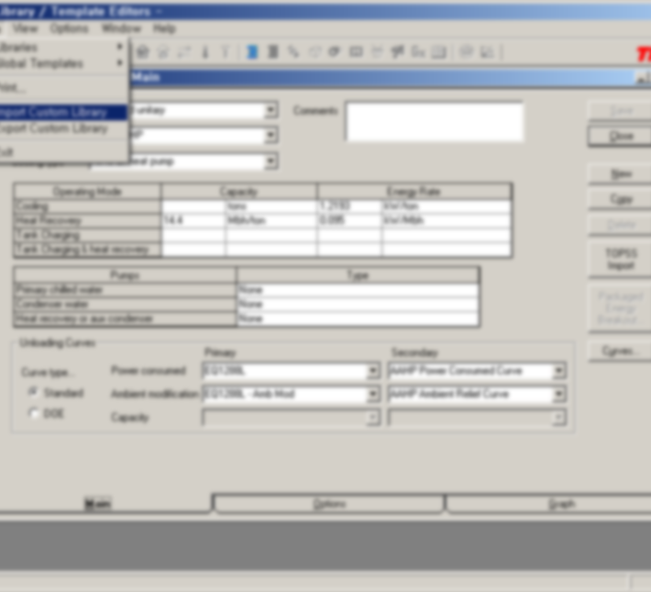
M&V Challenges
Balancing accuracy and reliability of measurements with the cost and rigor to perform them
Small savings make it difficult to justify costly measurements of multiple parameters
Translating measurements into savings adjustments

Slide 5
Non-condensing boiler
condensing boiler
Latent heat from combustion is lost in flue gas
Combustion efficiency of 80 to 87% for natural gas boiler
Hot water return temperature of at least 140 ˚F to prevent damage caused by condensation
Hot water return temperature have less impact on efficiency
Category I combustion appliance
Latent heat from combustion is partially recovered in condensing mode
Combustion efficiency of 90 to 99% in condensing mode
Constructed to withstand corrosion caused by condensation
Reducing hot water return temperature below flue gas dewpoint (130 ˚F) increases efficiency
Category IV combustion appliance
Notes:
Category I. An appliance that operates with a nonpositive vent static pressure and with a vent gas temperature that avoids excessive condensate production in the vent. Category II. An appliance that operates with a nonpositive vent static pressure and with a vent gas temperature that is capable of causing excessive condensate production in the vent. Category III. An appliance that operates with a positive vent static pressure and with a vent gas temperature that avoids excessive condensate production in the vent. Category IV. An appliance that operates with a positive vent static pressure and with a vent gas temperature that is capable of causing excessive condensate production in the vent.

Slide 6
Impact of firing rate on combustion efficiency
Based on data from Cleaver-Brooks for natural gas fired boilers

Slide 7
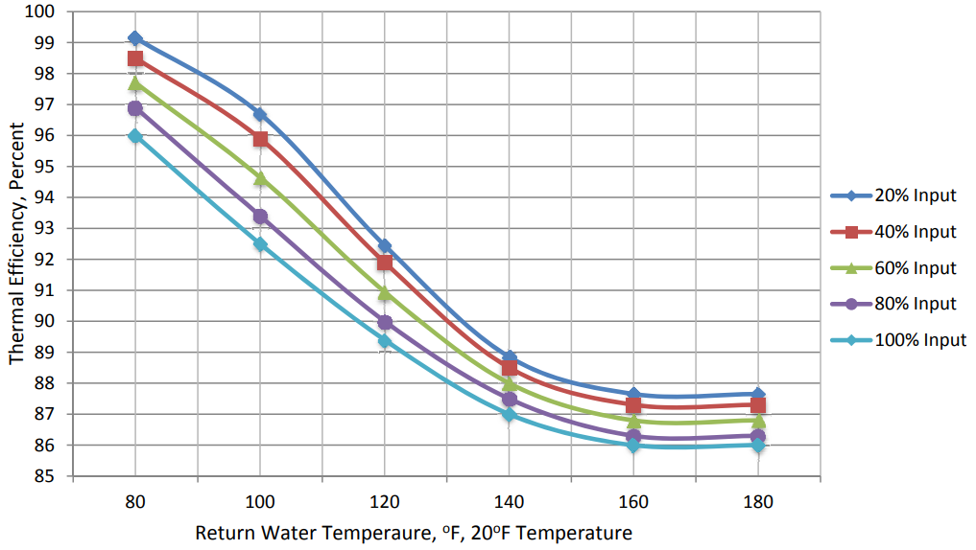
Impact of Return Water Temperature on Efficiency
Non-Condensing Mode
Condensing Mode
Difference
From Engineering Data for Fulton VTG-5000. Fuel is natural gas.

Slide 8
Boiler Measurement & verification
Option A, B, C, or D can be used for boiler replacement measures
Most common approach is Option A – retrofit isolation with key parameter measurement
Key parameter: Combustion Efficiency
Combustion efficiency is the percentage of useful heat utilized from combustion of a fuel
How to measure combustion efficiency?
Factor affecting condensing boiler efficiency: Hot water return temperature, firing rate, and ∆ T
Notes:
Note that utilizing Options B, C, or D may result in a slightly different boiler plant efficiencies.
Savings calculations for a boiler retrofit measure are based on plant efficiency.
Option B using parameters boiler heat output (BTU meter) and fuel usage (gas meter) would measure thermal efficiency (combustion efficiency - skin losses)
Option C would measure hot water plant efficiency, which includes all losses in the hot water system that we will touch on in a
Option D probably depends on modeling assumptions and the modeling software.

Slide 9
Average Plant efficiency
Sample “Steam to Condensing HW” values
Average Plant Efficiency (APE) = CE – (SkinLoss + CycLoss + SysLoss + PipeLoss), where:
CE = Combustion Efficiency
SkinLoss = Boiler Skin Losses %
CycLoss = Cycling Purge Losses %
SysLoss = Steam Trap and Condensate Losses %
PipeLoss = Distribution Piping Losses %
Combustion Efficiency is not always the only driver for savings. Is it still the “Critical Variable?”
 | Existing | New
SkinLoss | 2% | 0.5%
CycLoss | 4% | 0%
SysLoss | 2% | 0%
PipeLoss | 5% | 1.5%
Total | 13% | 2%

Slide 10
methods of Measuring combustion efficiency
AHRI 1500: Performance Rating of Commercial Space Heating Boilers
BTS-2000: Efficiency of Commercial Space Heating Boilers
ASME PTC-4: Fired Steam Generators
The Direct Method – “Input-Output Method”
The Indirect Method – “Heat Loss Method”
AHRI 1261: Performance Rating of Portable Flue Gas Combustion Analyzers

Slide 11
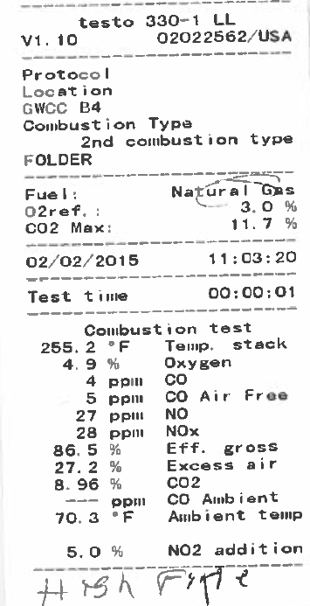
combustion efficiency Calculation
$Excess Air=\frac{89.9∗O_{2,\%}}{20.946−O_{2,\%}}$
Combustion Efficiency = 100 – DFL – WFL – UBL + C_eff, where:
DFL = Dry Flue Losses
WFL = Wet Flue Losses
UBL = Unburned Carbon Losses
C_eff = Condensing Efficiency

Slide 12
AHRI 1500/BTS-2000: Efficiency of space heating Boilers
Standard calls for the following:
Measure flue gas CO² (or O²) and CO concentration
Measure flue gas and combustion air temperature with 9-point thermocouple grid
Record condensate mass for 30-minute interval after reaching steady state
Meter gas input volume
Measure gas caloric value or use bottled gas
Maintain HWS temperature at 180 +/- 2˚F and HWR temperature at 80 +/- 2˚F
Notes:
What is the goal of M&V? How precise do measurements need to be?
This is the standard used to rate a boiler in a controlled environment.
It is not practical or meaningful to measure every variable to the ninth decimal place.
This approach is too challenging to implement on an actual project because

Slide 13
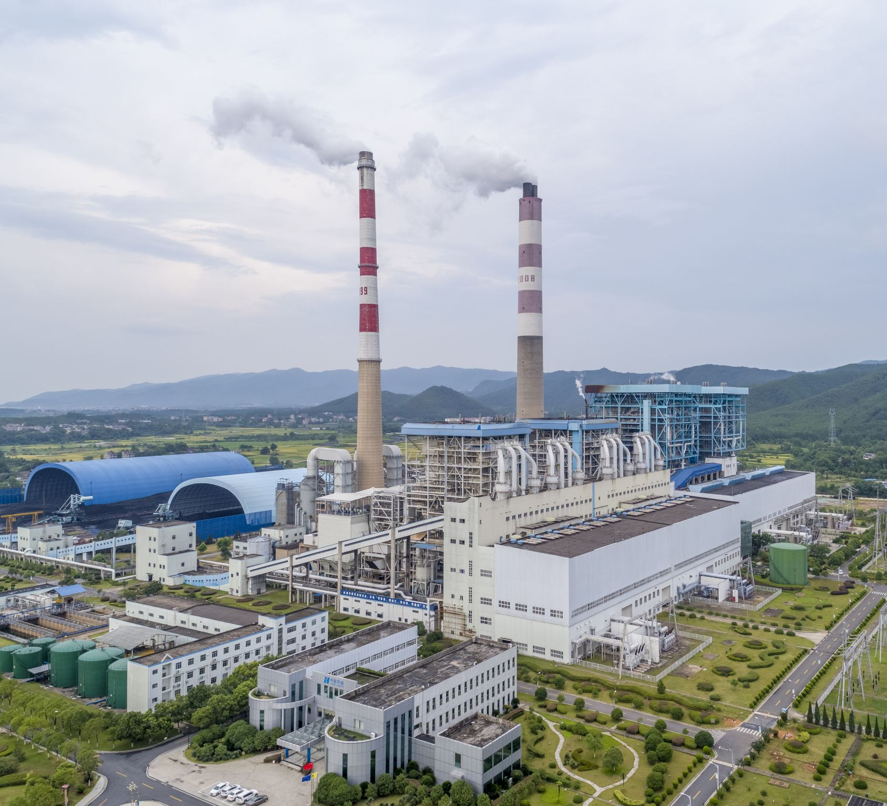
Field testing Approach based on BTS-2000
Field testing approach uses the following:
Measure flue gas CO₂ (or O₂) and CO concentration
Measure flue gas and combustion air temperature with combustion analyzer
Record time to fill 1-liter container
Gas input volume based on manufacturer’s data
Assume Higher Heating Value or calculate based on gas composition
Test at multiple HWR temperatures and firing rates

Slide 14
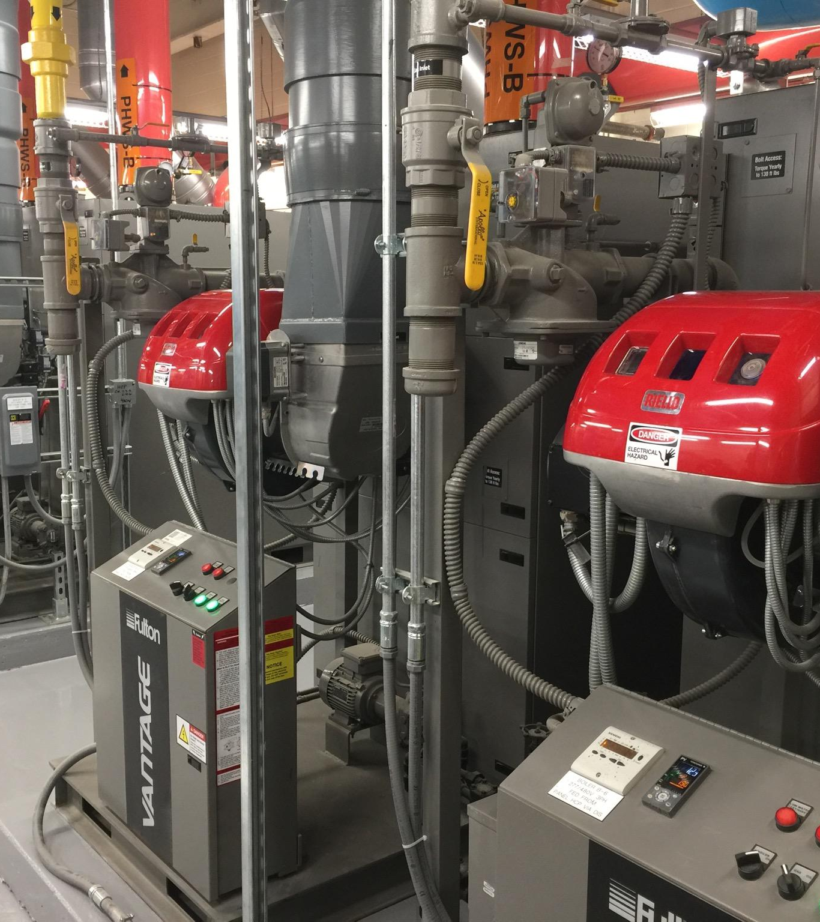
Field Measurements
Notes:
Measuring key parameters in the field can be challenging. I

Slide 15
Challenges with measuring Steady-State Condensate
Clogged drain piping
Access issues for physical measurement
Limited container height
Variable boiler load in real building
When is condensate production at steady state?

Slide 16
Measuring condensate with Psychrometrics and Chemistry
Chemical Equation for Natural Gas Combustion:
Flue gas leaves the boiler saturated, which allows the amount of condensate to be calculated using psychrometrics
Combustion produces 2 moles of water vapor for each mole of natural gas
Perfect combustion requires 2.02 moles of air for each mole of natural gas
Actual combustion air:
$$mol_{air}=2.02∗(1+ExcessAir)$$
Notes:
Alkane nomenclature: Methyl (1 C), Ethyl (2 C), Propyl (2 C)

Slide 17
Measuring condensate with Psychrometrics and Chemistry
Humidity Ratio of combustion products:
$$w_{i}= \frac{{Mass}_{wv,CombustionAir}+Mass_{water}}{Mass_{DryProducts}}$$
Flue gas leaves at a saturated condition:
$$w_{f,sat}=w \left(T_{stack}, RH=100\%, P\right)$$
$Mass_{condensate}=Mass_{DryProducts}∗(w_{i}−w_{f,sat})$

Slide 18
AHRI 1261: Performance rating of portable flue gas analyzers
Inputs for calculating combustion efficiency:
Flue gas temperature
Combustion air temperature (measure with optional temperature probe)
Flue gas CO₂ (or O₂) and CO
Fuel type
CE = 100 – DFL – WFL – UBL + C_eff
Notes:
Combustion efficiency [CE] = 100% - Dry Flue Losses [DFL] – Wet Flue Losses [WFL] – UnBurned Losses [UBL] + Condensing Efficiency [C_eff]
DFL and WFL are calculated from O2 in flue gases with equations derived from heat content of the fuel and combustion chemistry
UBL is calculated from CO in flue gases
C_eff is the additional heat captured by condensing water vapor from flue gas. This only applies to condensing boilers operated in the condensing range [HWR temperature]

Slide 19
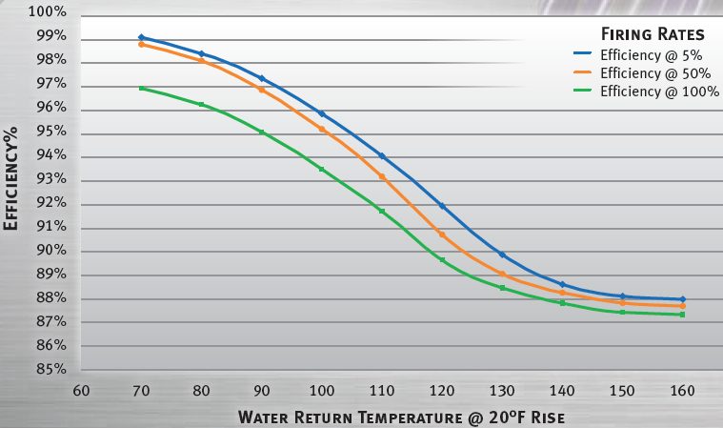
Translating Measurements into savings
Establish baseline annual boiler load
Stipulate hot water reset algorithm and weather data
Measure combustion efficiency at multiple firing rates and return water temperatures
Compare measured efficiency to rated efficiency
Take credit for reduced losses due to lower hot water temperature and improved turndown ratio

Slide 20
Calculating Savings
$Savings \left(therms\right)=Consumption(therms)− \left(\frac{Consumption(therms)}{{APE}_{exist}}∗{APE}_{new}\right)$
Compare measured efficiency to rated efficiency: ${Diff}_{avg}=AVG\left(\frac{Measured CE}{Reported CE}\right)$
Adjust efficiency at typical operating condition:
${CE}_{Adjusted}={Reported CE}_{@HWR=110°F \& 50\%load}∗{Diff}_{avg}$
Average Plant Efficiency (APE):
$$APE={CE}_{Adjusted}– (SkinLoss + CycLoss + SysLoss + PipeLoss)$$

Slide 21
Average Plant efficiency
Sample “Steam to Condensing HW” values
Average Plant Efficiency (APE) = CE – (SkinLoss + CycLoss + SysLoss + PipeLoss), where:
CE = Combustion Efficiency
SkinLoss = Boiler Skin Losses %
CycLoss = Cycling Purge Losses %
SysLoss = Steam Trap and Condensate Losses %
PipeLoss = Distribution Piping Losses %
Combustion Efficiency is not always the only driver for savings. Is it still the “Critical Variable?”
 | Existing | New
SkinLoss | 2% | 0.5%
CycLoss | 4% | 0%
SysLoss | 2% | 0%
PipeLoss | 5% | 1.5%
Total | 13% | 2%

Slide 22
Lessons Learned
Ensure boilers have been cleaned, drained, and serviced prior to combustion testing
Confirm that the boiler plant will be able to operate at condensing conditions when the test is performed
Select combustion gas analyzer with more accurate stack temperature probe
Calibrate flue gas analyzer
Standardize M&V process
Check the VFD speed and pump flow rates prior to all tests so that they are running optimally for the tests/load

Slide 23
Q&A
John Nott, PE, BEMP, CEM, CMVP
Principal Energy Engineer
TLC Engineering Solutions
John.nott@tlc-eng.com
Cody David, PE
Senior Energy Engineer
TLC Engineering Solutions
Cody.David@tlc-eng.com
Additional Support from:
Nathalie Shaffer, PE, CEM
Schneider Electric

