Slide 1
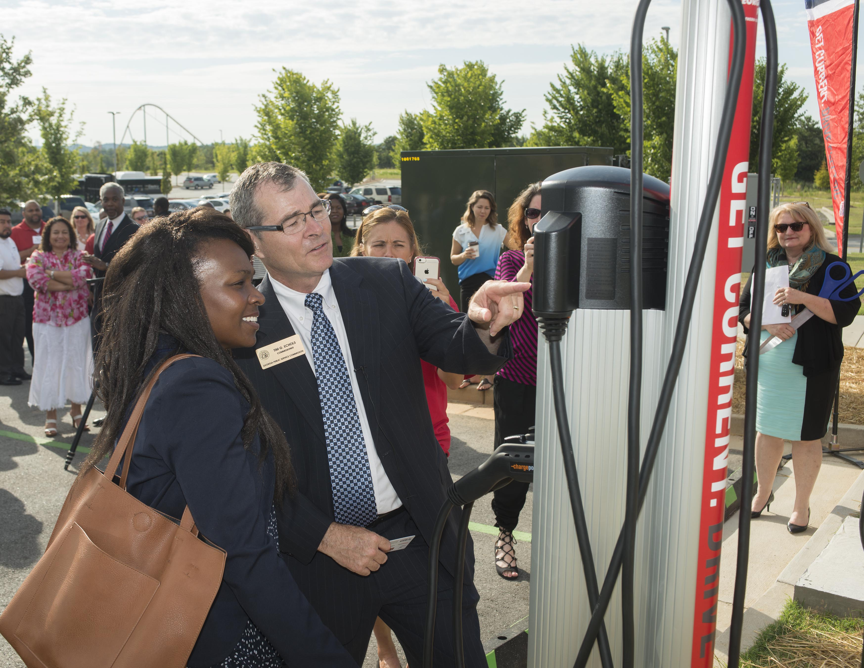
EV Evangelism

Slide 2
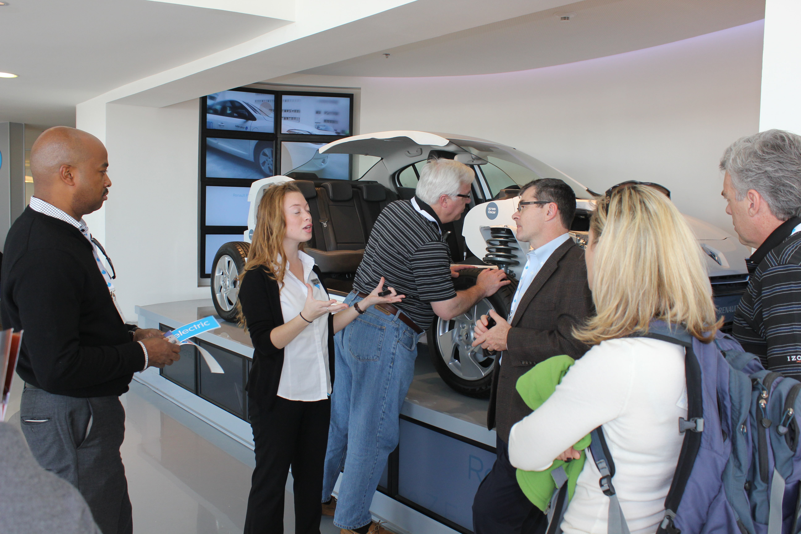
Better Place EV Testing Site, Israel 2011

Slide 3

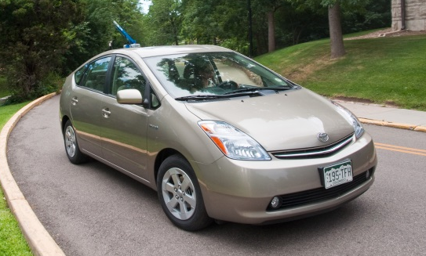

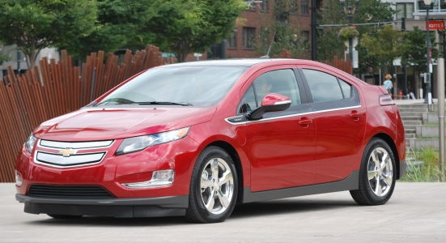
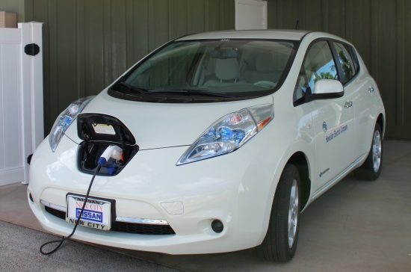

The Echols Experience
Hybrid Electric Vehicle (HEV)
Powered by an engine and electric motor
Does not use electric vehicle supply equipment (EVSE) to charge the battery
Plug-In Hybrid Electric Vehicle (PHEV)
Powered by an electric motor and engine
Uses EVSE to charge the battery
All-Electric Vehicle (EV)
Powered by an electric motor
Uses EVSE to charge the battery
Notes:
HEVs, such as the Toyota Prius, are powered by an internal combustion engine (using conventional or alternative fuel) and an electric motor that uses energy stored in a battery. HEVs do not need to be plugged in. Battery charging occurs through regenerative braking.
PHEVs use batteries to power an electric motor and use another fuel, such as gasoline or diesel, to power an internal combustion engine. PHEVs, such as the Chevrolet Volt, can also be referred to as extended range electric vehicles (EREVs). As their name implies, PHEVs can be plugged in to charge the battery. Depending on the type of PHEV, the vehicle may be powered by the battery, the internal combustion engine or a combination of both. A Chevy Volt can run on the battery or a combination of the battery and internal combustion engine. A Plug-In Prius can run on battery or the internal combustion engine.
EVs, such as the Nissan Leaf, use a battery to store the electrical energy that powers the motor. EVs are sometimes referred to as battery electric vehicles (BEVs). EV batteries are charged by plugging the vehicle in to an electric power source and do not use any other source of fuel.
(Images: NREL Image Gallery #24508, #18563, #)

Slide 4
Typical Reasons against EVs
Lost time charging
Range limitations
Technology soon out of date
Additional costs (upfront & chargers)
Employee dissatisfaction
Fuel card issues

Slide 5
Making the case to Conservatives
Charging at home, at night, provides better grid utilization and puts downward pressure on rates
Uses in-state fuel
Vehicles weigh less and have less impact on highways
Every one percent of petroleum-based miles travelled in GA that is displaced by electric vehicles, approximately $201 million dollars will remain in the state of Georgia annually.

Slide 6
Battery storage installed costs continue to drop
Cost declines of 8-10% year-on-year expected through mid 2020s
Bulk-scale 4-hour lithium-ion battery installed cost ($/kW)
Notes:
Nitzan
(we may add a slide on cost-effectiveness today)

Slide 7
Georgia Power Company’s 80 MW Battery Energy Storage Demonstration Projects
Draft Deployment Strategy
Approved by GPSC in the 2019 Integrated Resource Plan
Exact sizes, configurations locations, and use cases to be tested are still under development
65 MW LARGE STANDALONE BESS | SOLAR + 13 MW STORAGE | 2 MW SMALL STANDALONE BESS
Independently sited storage system | Located at or near a solar facility (solar + storage) | Independently sited storage systems
Connect to & charge from the transmission grid | Coupling a storage resource with a solar facility to evaluate the benefits, costs, and requirements of combining intermittent resources with a BESS | Connect to & charge from the distribution grid
65 MW 4-hour BESS, providing a total capacity of 260 MWh | 13 MW 4-hour BESS coupled with solar | One or more sites may be selected with a total capacity target of 2 MW
Notes:
65 MW Large Standalone BESS: Battery Energy Storage Systems
Transmission studies and vendor selection activities are in progress
Georgia Power anticipates filing the project plan with the PSC in Spring 2021
Expected Commercial Operation Date (“COD”) in the Fall of 2023
Solar + 13 MW Storage:
Site identification and technology assessments have begun; selection criteria based on minimizing cost and maximizing operational benefits and learning opportunities
Vendor selection is expected to occur in early 2021
Expected Commercial Operation Date (“COD”) in 2024
2 MW Small Standalone BESS:
Candidate site feasibility analysis is underway
These studies first evaluate the charging capability of the feeders to prevent negatively impacting reliability.
Subsequently, a BESS use case study will be performed to simulate operation of the BESS on the distribution feeder.
Results of this study will conclude which use case applications the BESS can perform, and the BESS capacity size required to complete the function.
Candidate sites that rank highest in both analyses and provide a low site development cost will make the short list for final site consideration.
Project(s) expected Commercial Operation Date (“COD”) is expected in 2022

Slide 8
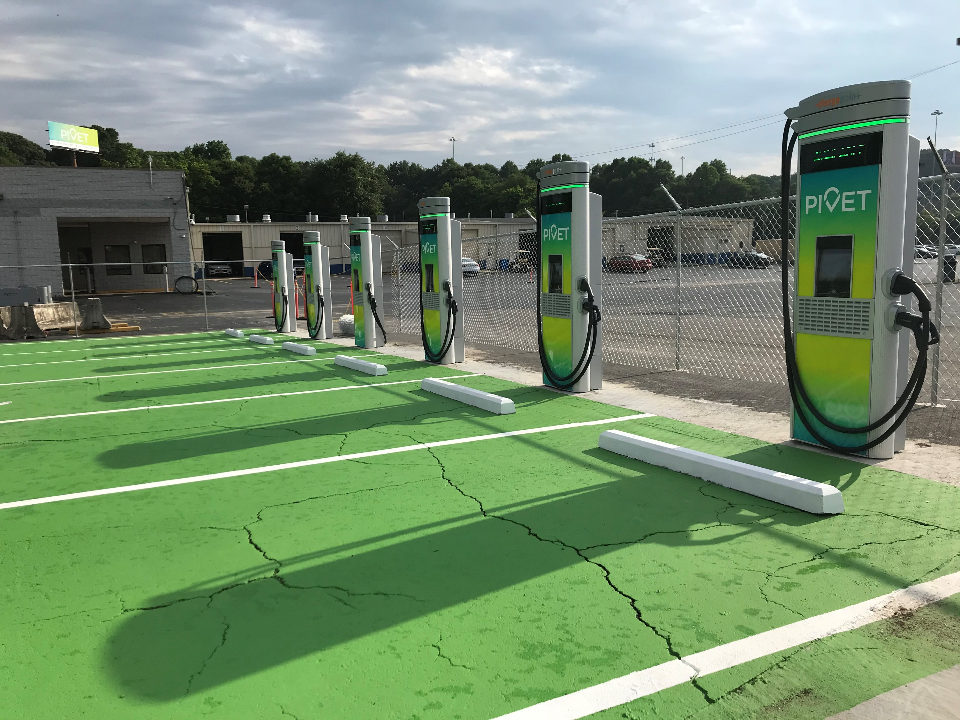
Georgia Power Company’s Used Lithium-Ion Battery Pilot
Project Details
Approved by GPSC in the 2019 Integrated Resource Plan
50 kWh / 50 kVA Battery Energy Storage System based on used Nissan LEAF batteries
Installation in Cox Automotive’s Pivet Atlanta mobility hub, using their chargers
Introduction of use cases like peak-shaving and insulating the grid from demand spikes due to intermittent charging
Southern Research in Birmingham conducting testing and commissioning
Pilot budget ~$250,000
Expected completion in 2021
Notes:
A cost-benefit analysis will be conducted
GPC will also analyze the effect of second-use EV batteries in such a system and keep track of battery degradation
“Georgia Power shall develop a pilot project utilizing used lithium ion batteries for a grid-connected charging system for electric vehicles. The goal for the pilot shall include keeping charging of clean electric vehicles affordable and insulating the grid from spikes in electricity demand. The cost of the pilot shall not exceed $250,000.”
Southern Research should begin construction later this year.

Slide 9
Can the government lead the way?
Add hybrids, plug-in hybrids and Chevy Bolt to procurement list with conditions:
Try fully-electric BOLTS with limited number of employees in Cobb EMC or Georgia Power territory with no home reimbursement for power
Employee gets charging key fobs to be used outside home
Limit acquisition to 100 fully-electric vehicles initially for 2 years and 100 Hybrids for non-Cobb EMC or GA Power TOU customers.
Compare operating costs including Gwinnett Peach Pass tolls (free to BOLTS)
Do focus group with employees
Ask Georgia Power for free infrastructure for these vehicles

Slide 10
Psc slowly integrating batteries
Additional 2000 MW of Utility Scale solar at market prices below avoided cost
210 MW of DG at solar avoided cost
80 MW of Utility Batteries
Additional STEM funding
2nd Life EV Pilot project
$24 million for chargers and charger-make-ready
2 Commissioners drive EVs

Slide 11
NEW VEHICLE MARKET SHARE YTD 2020 – TOP BRANDS BY SHARE GAIN/LOSS
Through September 2020
Source: Cox Automotive/KBB

Slide 12
National EV Share of Total New Vehicle Registrations
Source: IHS Markit

Slide 13
National EV Model Lineup
Source: IHS Markit

Slide 14
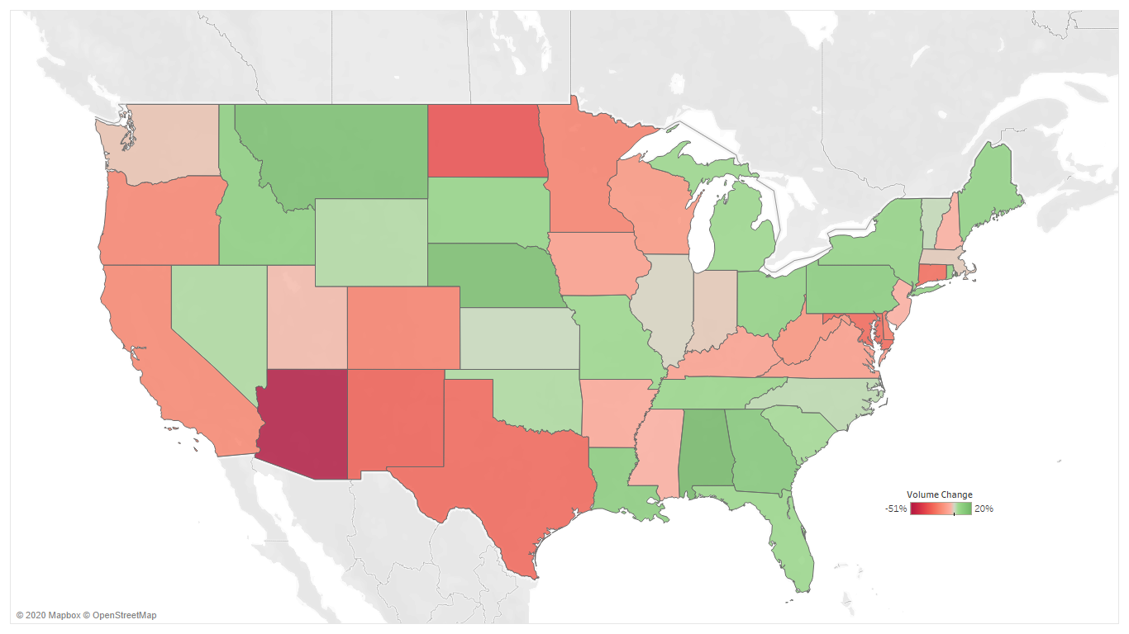
Total EV Volume Change By State (CYTD 2020)
Data through July 31, 2020
Source: IHS Markit

Slide 15
Georgia EV Share of Total New Vehicle Registrations
Source: IHS Markit

Slide 16

Georgia EVs By County
Source: IHS Markit

Slide 17
EVs Forecast To Grow in the US
Source: IHS Markit

Slide 18


MAJOR BARRIERS TO ADOPTION OF EVs
70%
Cost
83%
Charging/Battery
Source: 2019 Cox Automotive EV Study
Notes:
Non-considerers are reluctant in EV consideration as 2 major factors – Cost and Charging/Battery perceptions- are roadblocks.

Slide 19
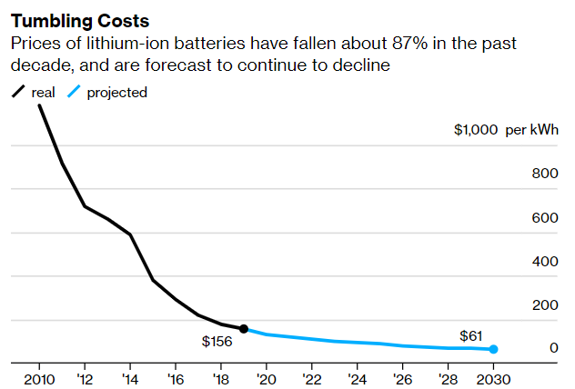
The Cost of Batteries Is Falling Fast
Note: 2019 USD prices
Source: Bloomberg NEF

Slide 20

Impact on Grid from EVs
Supply-Side
How much more energy
Demand Charges
Demand-Side Options
EV to Grid
EV charging House
Transmission
Possible impacts

Slide 21

Special thanks to
Jonathan Smoke and KC Boyce
Contact Information:
Jonathan Smoke
Chief Economist
Cox Automotive
jonathan.smoke@coxautoinc.com
@SmokeonCars

