Slide 1
Energy Resources Division Update
Energy Resource Division
February 23, 2026

Slide 2
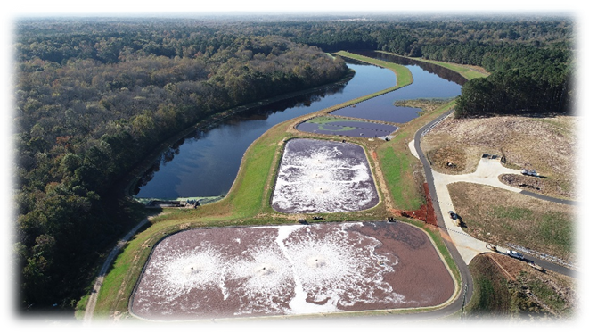
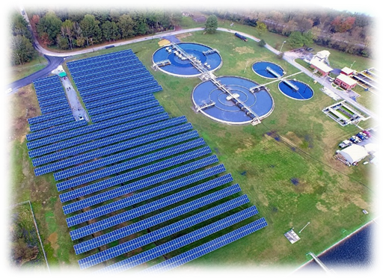
GEFA Overview
GEFA’s mission is to conserve and improve Georgia’s energy, land, and water resources.
Energy Resources Division
Water Resources Division

Slide 3
ERD Programs
Energy Resources Division Program Overview
  Provide federal funding to energy initiatives throughout the State of GA with a focus on energy efficiency, energy security and energy resiliency. Funding sources include:
    State Energy Program (SEP)
      Approx $1.4 million annually
      $10.8 million from IIJA
    IIJA programs:
      Energy Efficiency and Conservation Block Grant (EECBG) ($2.9 million)
      Energy Efficiency Revolving Loan Fund Capitalization Grant (EERLF) ($2.4 million)
      Grid Resiliency programs
        Grid Resilience and Innovation Partnerships (GRIP) ($250 million)
        40101d: Grid Resilience State And Tribal Formula Grant ($43 million)

Slide 4
SEP – Georgia Energy Grant
2025 Georgia Energy Grant Purpose:
To fund projects in energy planning, energy efficiency, workforce development, and Energy Resiliency.
Overall Budget: $566,286 where each grantee could request from $50,000 - $150,000 for their project
Grant was open to state and local governments, K-12 schools, public colleges/universities/technical colleges, and non-profits
Closed in June 2025
Grantees Selected:
Types of projects proposed
1 energy efficiency retrofits and upgrades/workforce development
1 energy resiliency
3 workforce development

Slide 5
SEP – ESPC Technical Assistance Program
2026 ESPC Technical Assistance Purpose:
In house Owners Representation to support local governments in Georgia, particularly smaller communities that often struggle to attract the attention of Energy Services Providers (ESPs)
Support throughout 2028 and looking to continue this in the future to further support of ESPC program
What services will be offered?
  Office Hours
  Direct Engagement
  Measurement and Verification (M&V) Support

Slide 6
Energy Savings Performance Contracting
ESPC History :
Before January 1, 2011, those buildings (MUSH) were allowed to acquire multi-year debt for those guaranteed energy-saving projects
Actively have 5 projects still reporting on their measurement and verification (M&V): GA Tech, Department of Corrections, Georgia World Congress Center, North Georgia Mountain Authority, Department of Transportation
Our Responsibilities:
Review and Manage Policies
Prequalify Energy Service Companies (ESCO) (15)
  Honeywell, Johnson Controls, OPTERRA, NORESCO, Trane, etc.
GSFIC Board
Guidance and Resources
Reporting
Final Approval

Slide 7
Energy Savings Performance Contracting
FY 2024 Project Savings:
Agency | GESPC Term | Realized Savings | Guaranteed Savings
Department of Corrections | 15 yrs | $3,346,237.00 | $3,160,458.00
Department of Corrections | 15 yrs | $572,650.00 | $511,110.00
Department of Transportation | 14 yrs | $338,471.00 | $291,525.00
Georgia Tech - Board of Regents | 7 yrs | $2,156,437.00 | $2,146,465.00
Georgia Tech - Board of Regents | 10 yrs | $1,254,684.00 | $1,095,403.00
Georgia World Congress Center Authority - DECD | 17 yrs | $2,686,551.00 | $2,514,237.00
North Georgia Mountains Authority - DNR | 15 yrs | $517,683.00 | $509,592.00
Upcoming Projects:
Board of Regents/UGA
Georgia World Congress Center (GWCC)
Total Savings = $10,872,713.00

Slide 8
Infrastructure Investment Jobs Act (IIJA) SEP
IIJA State Energy Program:
  Flexible appropriates through IIJA, approximately $10.4 million over the course of 4 years
  Allows states to pursue goals and projects related to energy conservation, energy policy, renewable energy, energy security, and energy-related workforce development. Additional federal requirements such as Buy America, Build America and Davis Bacon Act apply
  Example GEFA Uses and Priorities:
    Grants towards workforce efforts
    Heat pump training in partnership with GDOL and Goodwill of North Georgia.
    Georgia Tech "Energy Management and Report" course for Georgia SME's
    Scholarships for Technical Colleges including Building Operator Certification and Electric Vehicle Charger Technician Training
    Upgrade and re-launch of Solar Resiliency Program with GDS
    On-demand Energy Savings Performance Contracting technical assistance for municipalities and K-12 schools
    Energy consultant for new code cycle

Slide 9
EECBG
Energy Efficiency and Conservation Block Grant (EECBG)
  Funded by IIJA of 2021, and previously by ARRA fundings in 2011....
  Provides funding for local governments to invest into energy audits, energy efficiency upgrades, fleet electrification, and workforce programs.
  GEFA focused on identifying and selecting applicants from rural and disadvantaged communities.
  $2.9 million, allocated in awards of $150,000
Our Responsibilities
  Program Design
  Monthly Check-in Calls and on-site monitoring
  Federal Reporting and Compliance; quarterly metrics, Davis Bacon Act, Buy America Build America
  Tracking and submitting invoices
  Additional SEP funds were used to fund projects from the EECBG waitlist

Slide 10
EECBG
City of Fort Gaines - EE Audits and Upgrades
City of Lenox - EE Audits and Upgrades
City of Moultrie - EE Audits and Upgrades
City of Tennille - Workforce Development
Clay County - EE Audits and Upgrades
Colquitt County - EE Audits and Upgrades
Randolph County - EE Audits and Upgrades
Schley County - EE Audits and Upgrades
Stewart County - Energy Planning and Upgrades
Taylor County - EE Audits and Upgrades
Unified Govt. of Georgetown-Quitman County - EE Audits and Upgrades
Chatham County - Energy Planning and Audits
City of Cedartown - E.V. and Fleet Transition
City of Buena Vista - EE Audits and Upgrades
City of Covington - E.V. and Fleet Transition
City of Jackson - E.V. and Fleet Transition
Montgomery County - EE Audits and Upgrades
Unified Govt. of Webster County - EE Audits and Upgrades

Slide 11
Energy Resource Division
47 Trinity Ave SW
Fifth Floor
Atlanta, GA 30334
gefa.georgia.gov

